Slide 1
Case Tracking System
Managing Legal Documents and Client Records Efficiently

Slide 2

Introduction
Welcome to the presentation on "Intelligent Case Tracking System for Law Firm Management."
In today's fast-paced legal environment, law firms handle a vast amount of sensitive data, including legal cases, client information, and court schedules. Managing these efficiently while ensuring data security and timely case resolution can be a challenge.

Slide 3

Introduction
Our project aims to address these challenges by developing an innovative Case Management System designed specifically for law firms. This system streamlines case tracking, automates alerts for important court hearings, and enhances document security through role-based access control.
In this presentation, we will walk you through the system's features, its architecture, and how it improves case handling and document management, ultimately enhancing law firm operations.
Let’s dive in!

Slide 4
01
System Overview

Slide 5

Purpose of the case tracking system
This system is designed to streamline the management of legal cases by organizing legal documents, client information, and court schedules.
It serves to improve efficiency, enhance accessibility to important records, and ensure compliance with legal standards.

Slide 6
Key features and functionalities
Key features include document management, alert systems for hearings, client record integration, and analytical tools for case performance.
It also provides a user-friendly interface to simplify navigation and usability for various stakeholders.

Slide 7
User roles and access levels
The system supports various user roles, including administrators, lawyers, and support staff, each with customizable access levels to ensure data security and privacy.
This allows for tailored experiences based on user responsibilities.

Slide 8
02
Document Management

Slide 9
Types of legal documents managed
The system handles a variety of legal documents such as contracts, briefs, legal letters, court filings, and case notes.
Each document type is categorized for easy retrieval and management.

Slide 10

Document access control mechanisms
Robust access control mechanisms are implemented to ensure that sensitive documents are only accessible to authorized users.
Role-based permissions safeguard against unauthorized access and data breaches.

Slide 11
Versioning and tracking changes
The system maintains an audit trail of document changes, allowing users to track revisions and updates.
This ensures accountability and aids in compliance with legal requirements for documentation.

Slide 12
03
Client Records

Slide 13
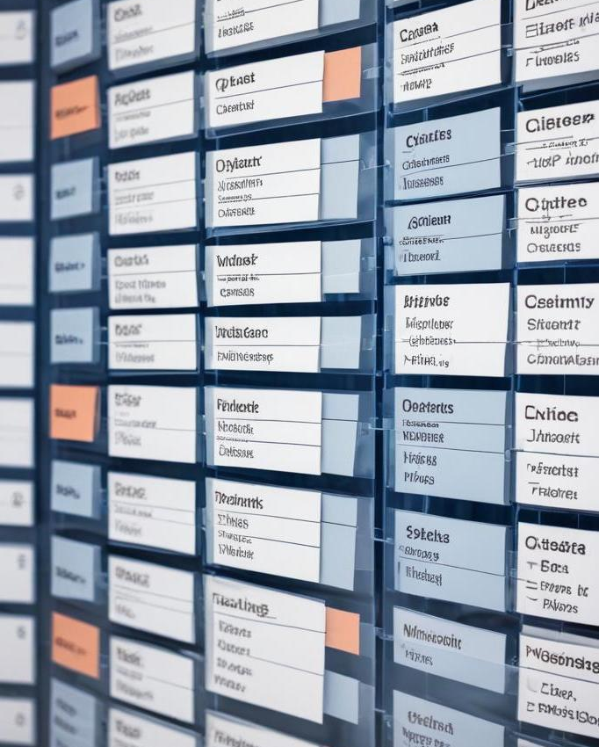
Data structure for client information
The data structure for client records includes key fields such as client name, contact details, case history, and unique identifiers.
This allows for efficient categorization and retrieval of essential client information, enabling seamless access for authorized users.

Slide 14
Privacy and data security measures
To maintain client confidentiality, robust encryption methods and access controls are implemented.
Data is stored securely, with regular backups and compliance with legal privacy regulations ensuring that sensitive information remains protected from unauthorized access.

Slide 15
Integration with case files
Client records are seamlessly integrated with corresponding case files, allowing for contextual information access.
This integration facilitates quick lookup of client-related documents and improves overall case handling efficiency.

Slide 16
04
Technical Implementation

Slide 17
Database Management System (DBMS) selection
Choosing the right DBMS is crucial for performance and scalability.
The selected MySql will support the extensive data requirements of over 10,000 case records while ensuring reliability and fast access to information.

Slide 18

Utilization of Business Intelligence techniques
Business Intelligence techniques will analyze case trends and outcomes, providing valuable insights for decision-making.
This data-driven approach will enhance strategic planning and improve overall case management.

Slide 19
SQL for data retrieval and management
SQL will be utilized for efficient data retrieval and management, allowing users to execute complex queries that enhance reporting capabilities.
This ensures that users can access and manipulate data effectively.

Slide 20
Conclusions
In conclusion, the implementation of a comprehensive case tracking system will enhance the management of legal documents and client records.
By integrating robust security measures and efficient scheduling tools, the system aims to improve overall case handling processes.

Slide 21
Thank you!
Do you have any questions?
Please keep this slide for attribution

